Slide 1
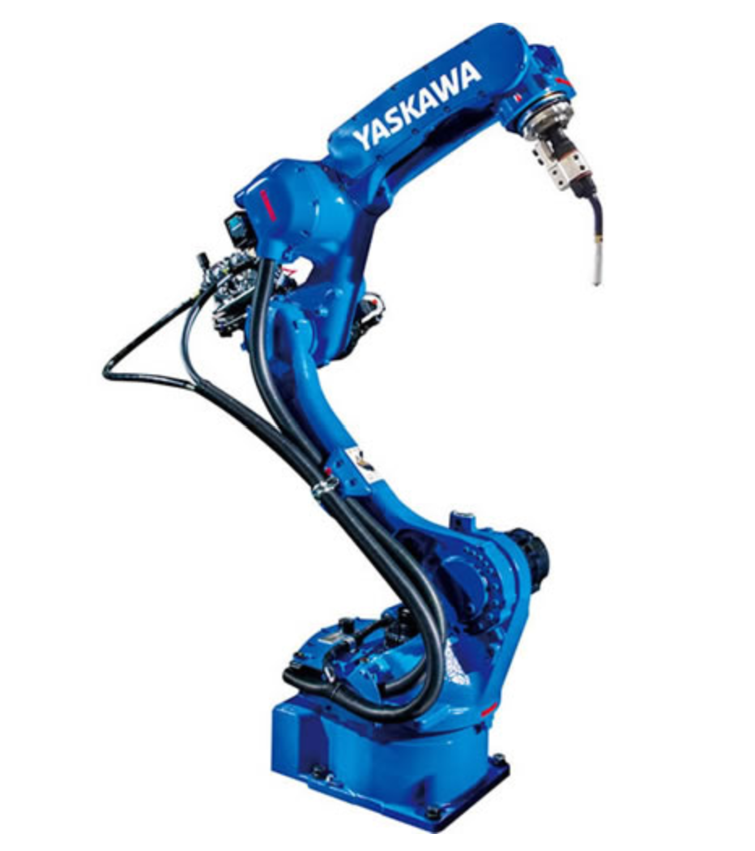
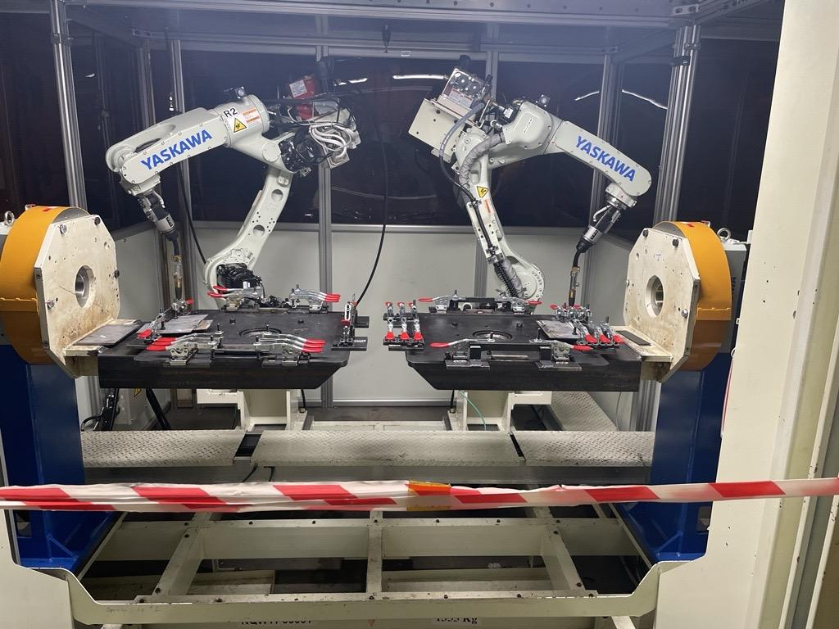

Next Gen Training Cell Jig New Concept
10/12/2023
THIS

Slide 2

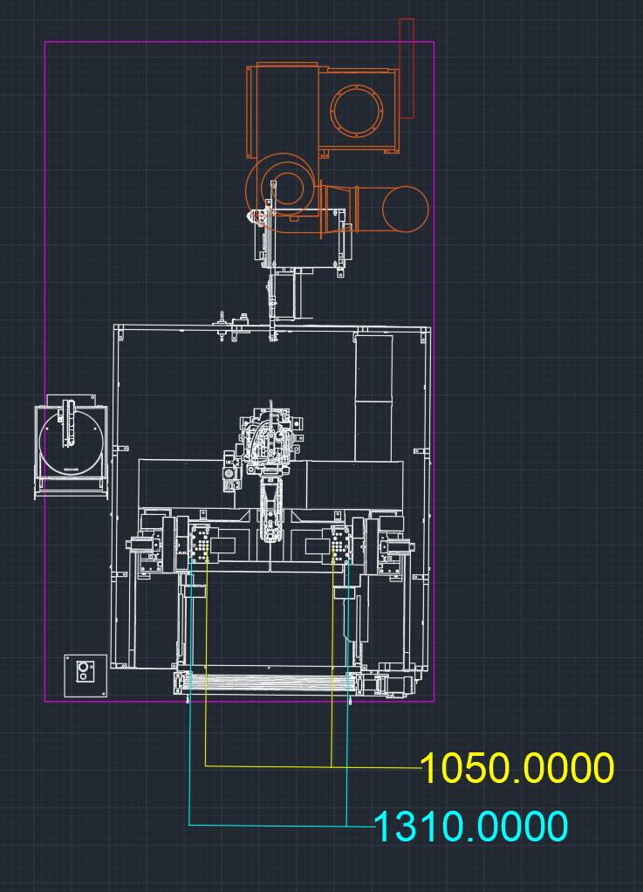
Design Flow
DESIGN FOCUS
Safety
Easy accessibility to all parts of the Jig
Ergonomic enough to operate in full PPE gear
Quality
Reduce risk of weld failure due to Jig setup
Stress free experience/ easy setup/repeatability
Functionality
Easy reach points for the robot
As many welding variation possible
Enhancing team member understanding of the new technology
Cost
Under $10,000 for all equipment needed
Notes:
Same design process as last time, and we are working with the same space for the jig table In a 1R1P

Slide 3
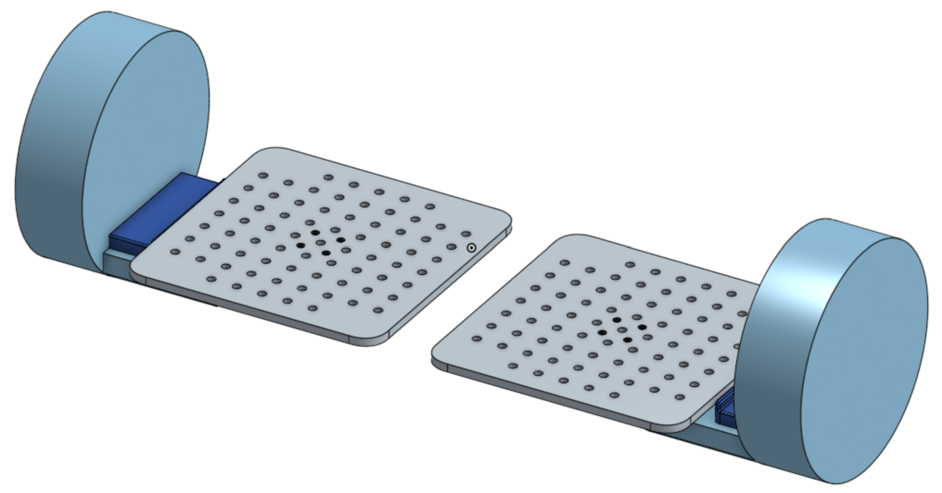
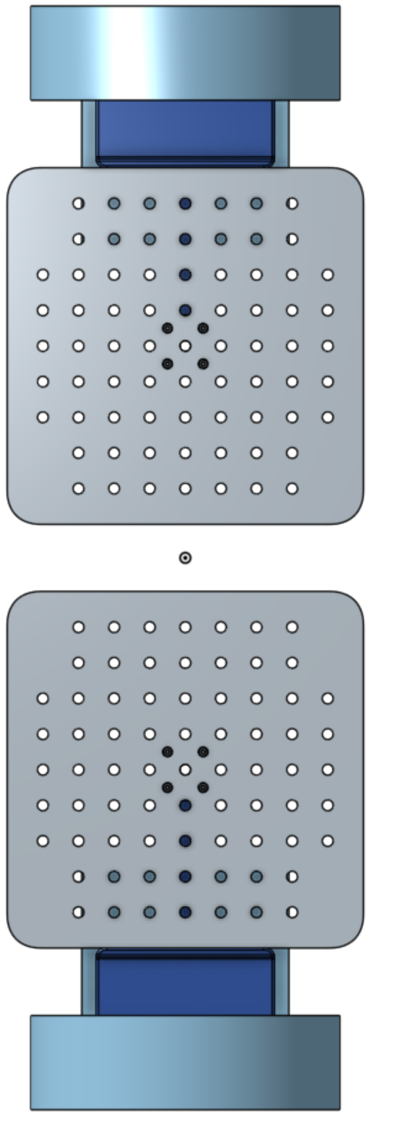
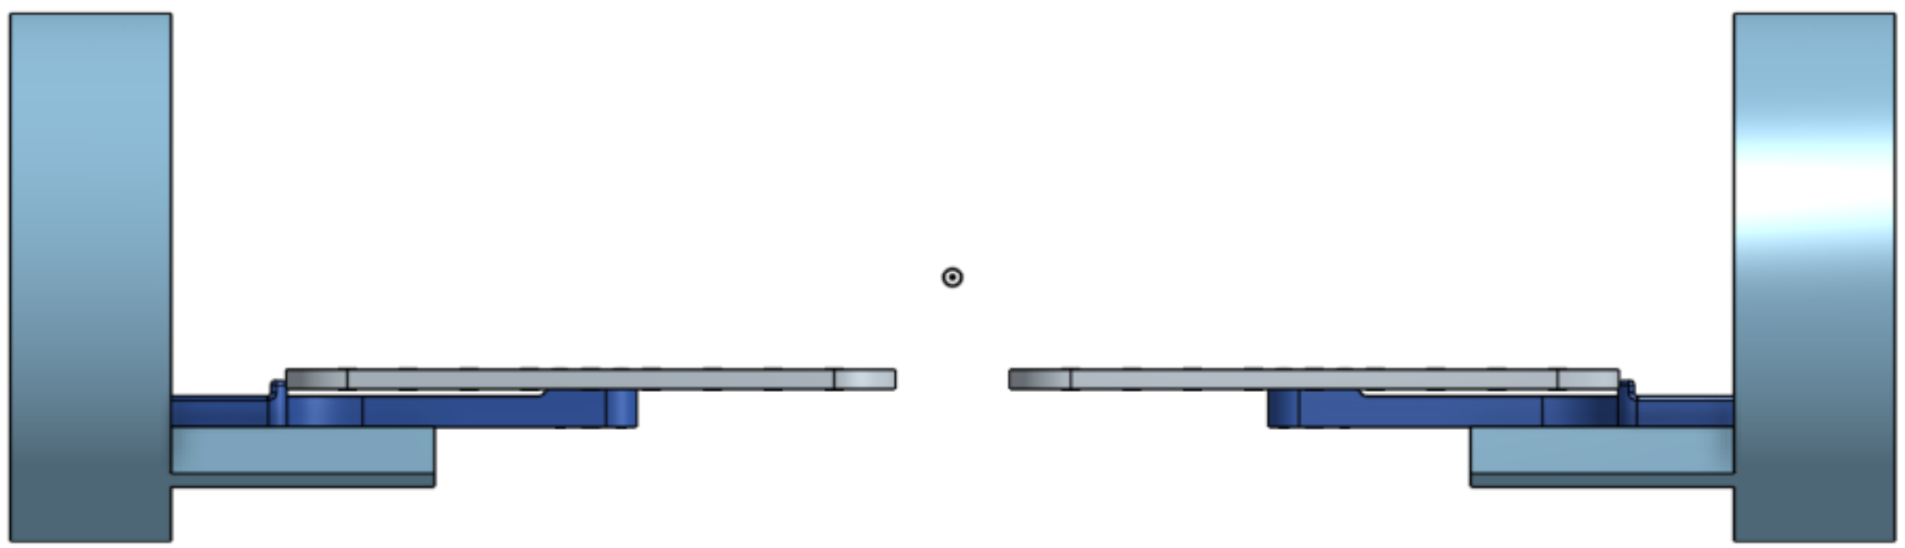
Updated Design
2 inch spacing, 5/8in or 16mm holes, aprox. 73 holes per side
Attached by M8 Screws
Table Dim: 20inx20inx0.625in
508mmx508mmx15.875mm
Notes:
Using the information and suggestions in the last meeting, I have designed a jig that has 2 main parts. the first is the table with two inch spacing and 5/8 inch diameter holes. There are approximately 73 holes per side so that’s 146 holes that would have to be drilled. The second part is the table holder. In a case where the table is destroyed in some way, we can detach the table by the M8 screws and make that replacement.

Slide 4
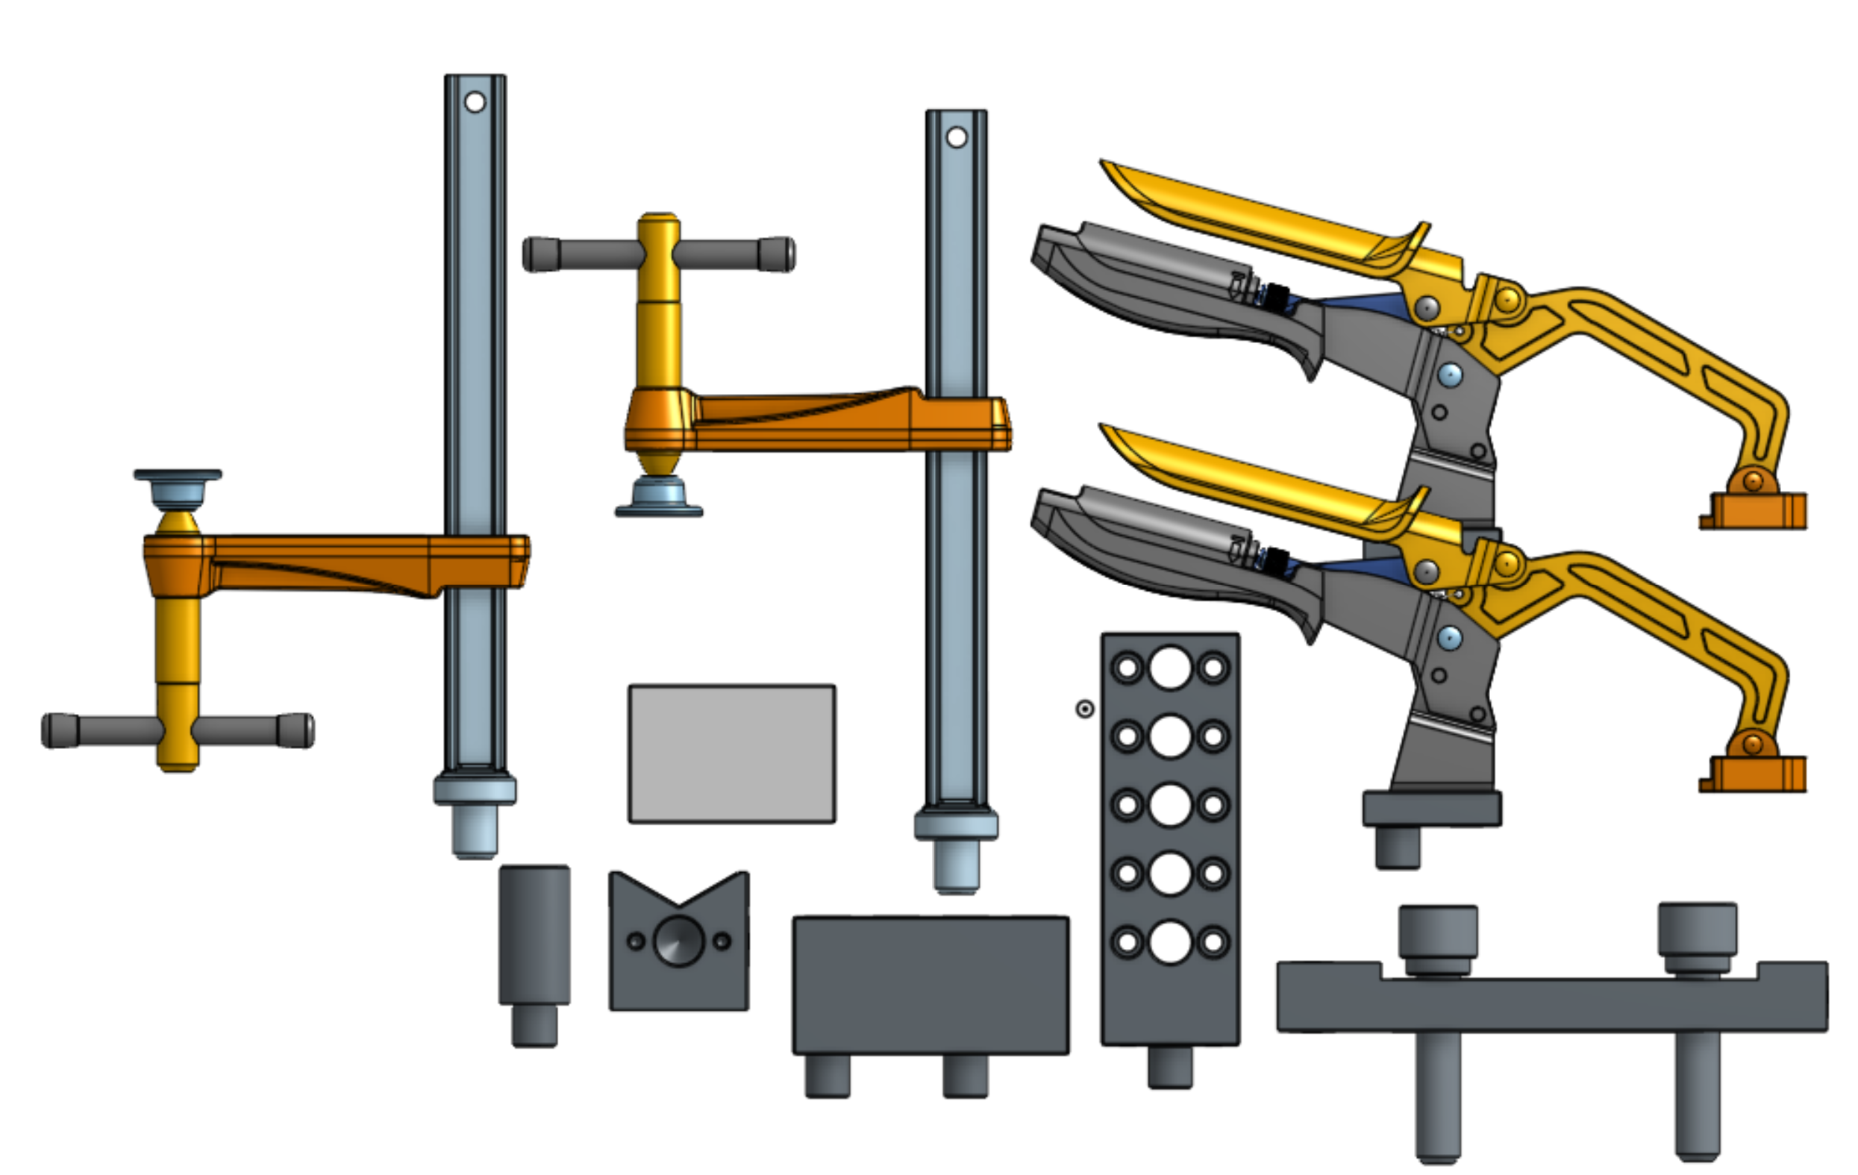
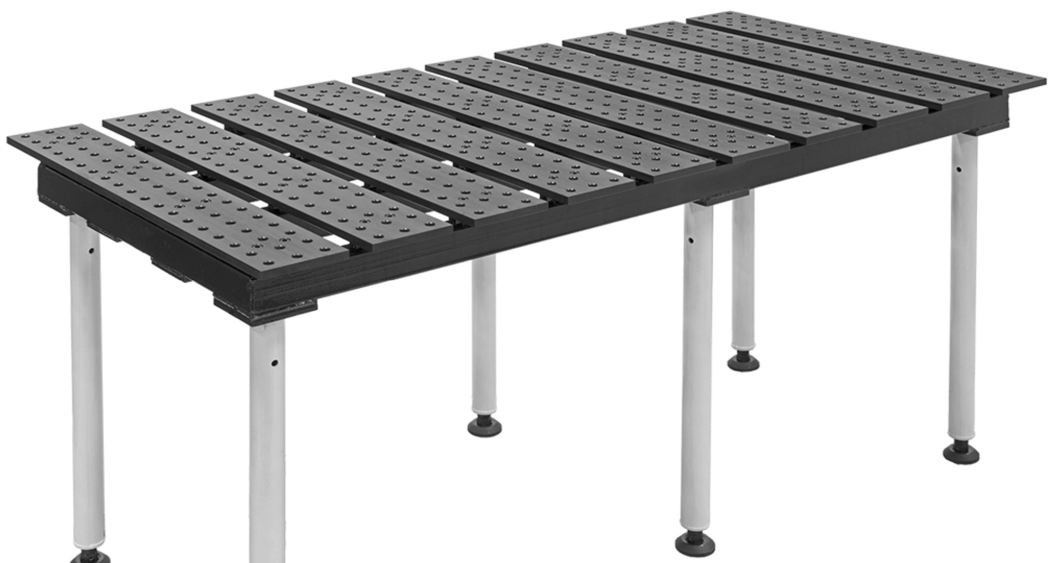
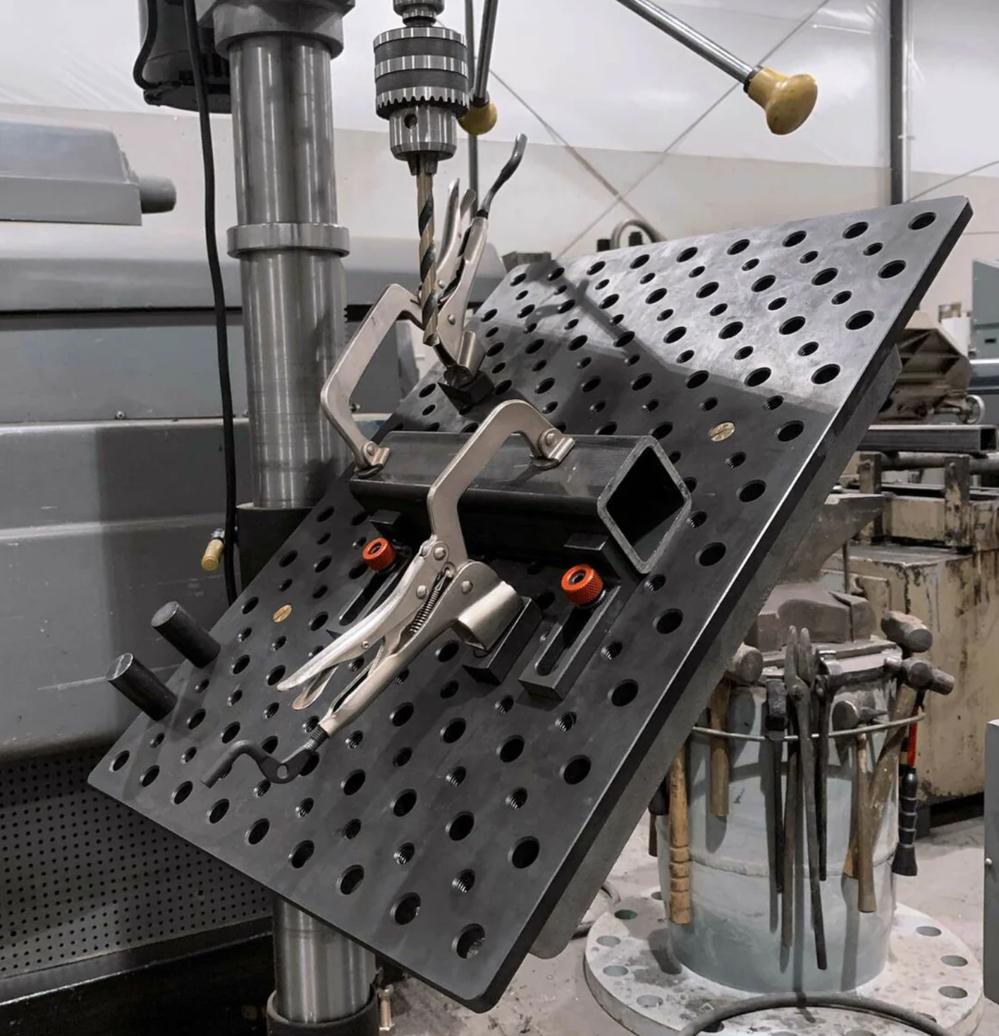
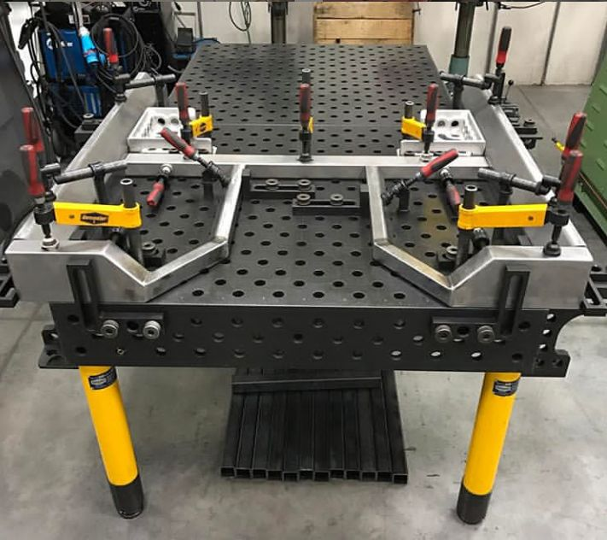
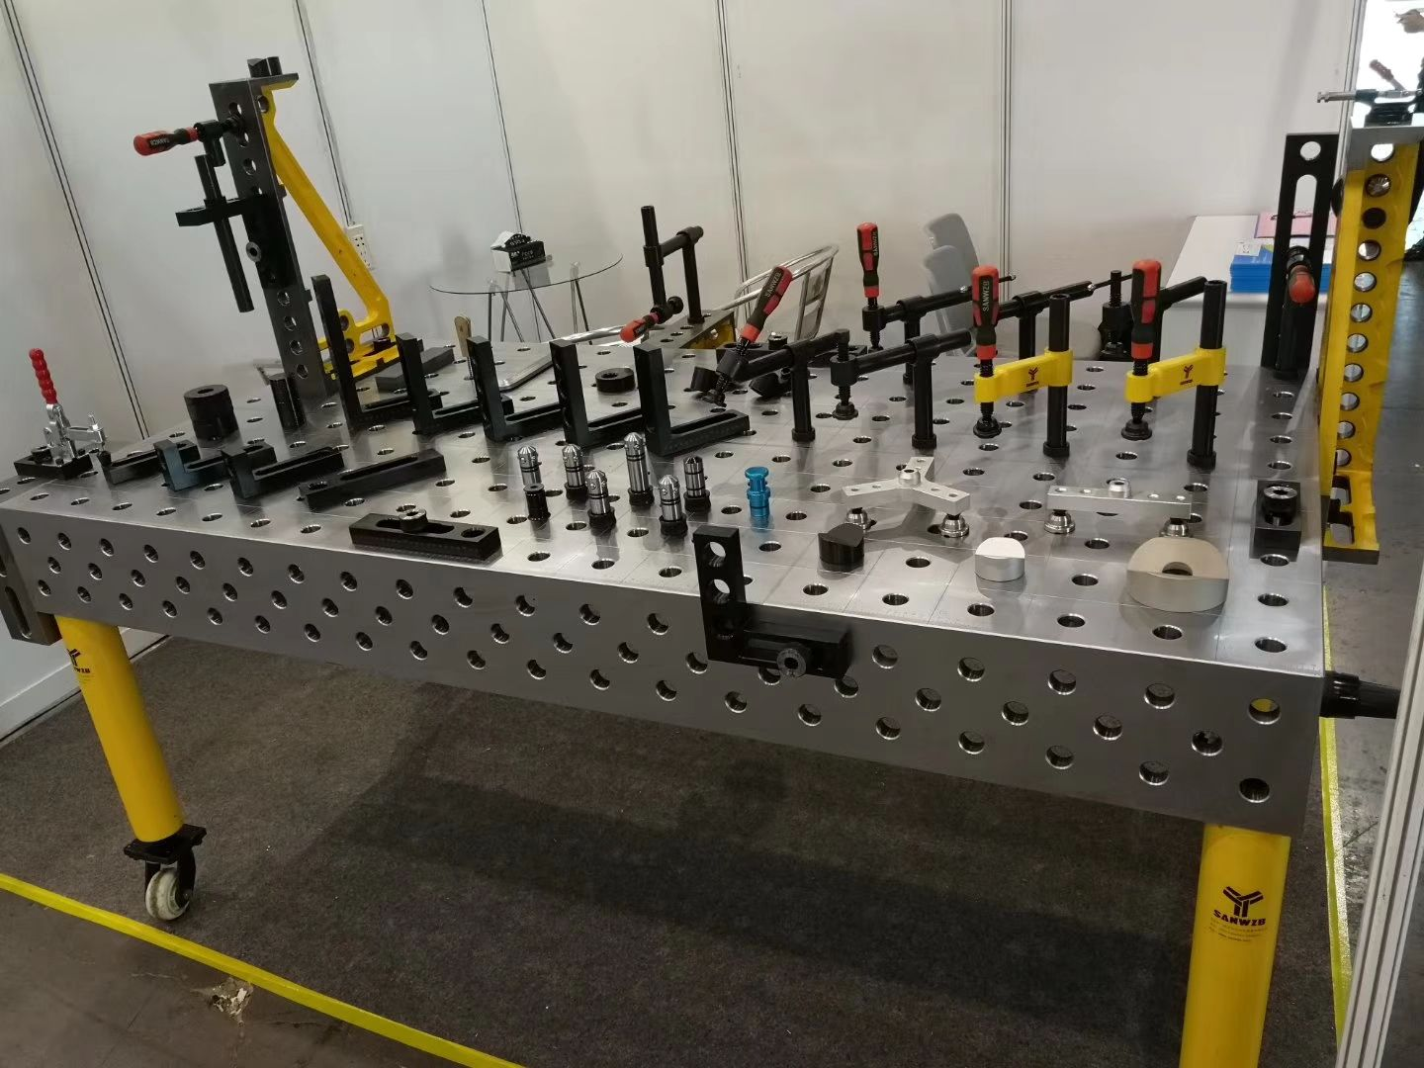
Components Overview
Clamps
Spacers, and shims
Vee Block
Fence Blocks, guide pins and extenders
Notes:
The name for this style of table is called a fixture table or weld table. Its been in the welding industry for a little bit and has been proven to be an accurate way to setup a project. The spacing typically used is two inches, and depending on the size of the table the hole sizes varies. For smaller tables like ours 5/8 diameter is common, then 16mm if we are using metric clamps. One of the concerns for this style of jig is the ability to go 360 without anything falling out or off and I will talk about that in the next few slides on how we can solve this concern

Slide 5
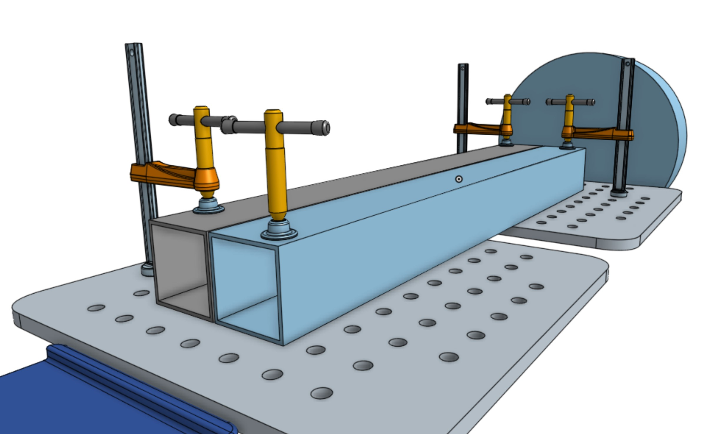
Weld Distance & Operation
~900mm
Notes:
The total weld distance is somewhere around 900 millimeters or 35 inches, it can be more but that’s what I have found to be a reasonable distance to weld and find the affect of welding for that long on a material. Now how the table works is pretty simple. There are special type of clamps that has a base the fits into one of the table’s holes. When clamping down on a part these clamp have a slight angle to the base and body. That slight angle is what helps the clamp stay inside the table’s hole. The opposing force of the part causes the base of the clamp to have two points of contact on the table and essentially locks the clamp in place.

Slide 6
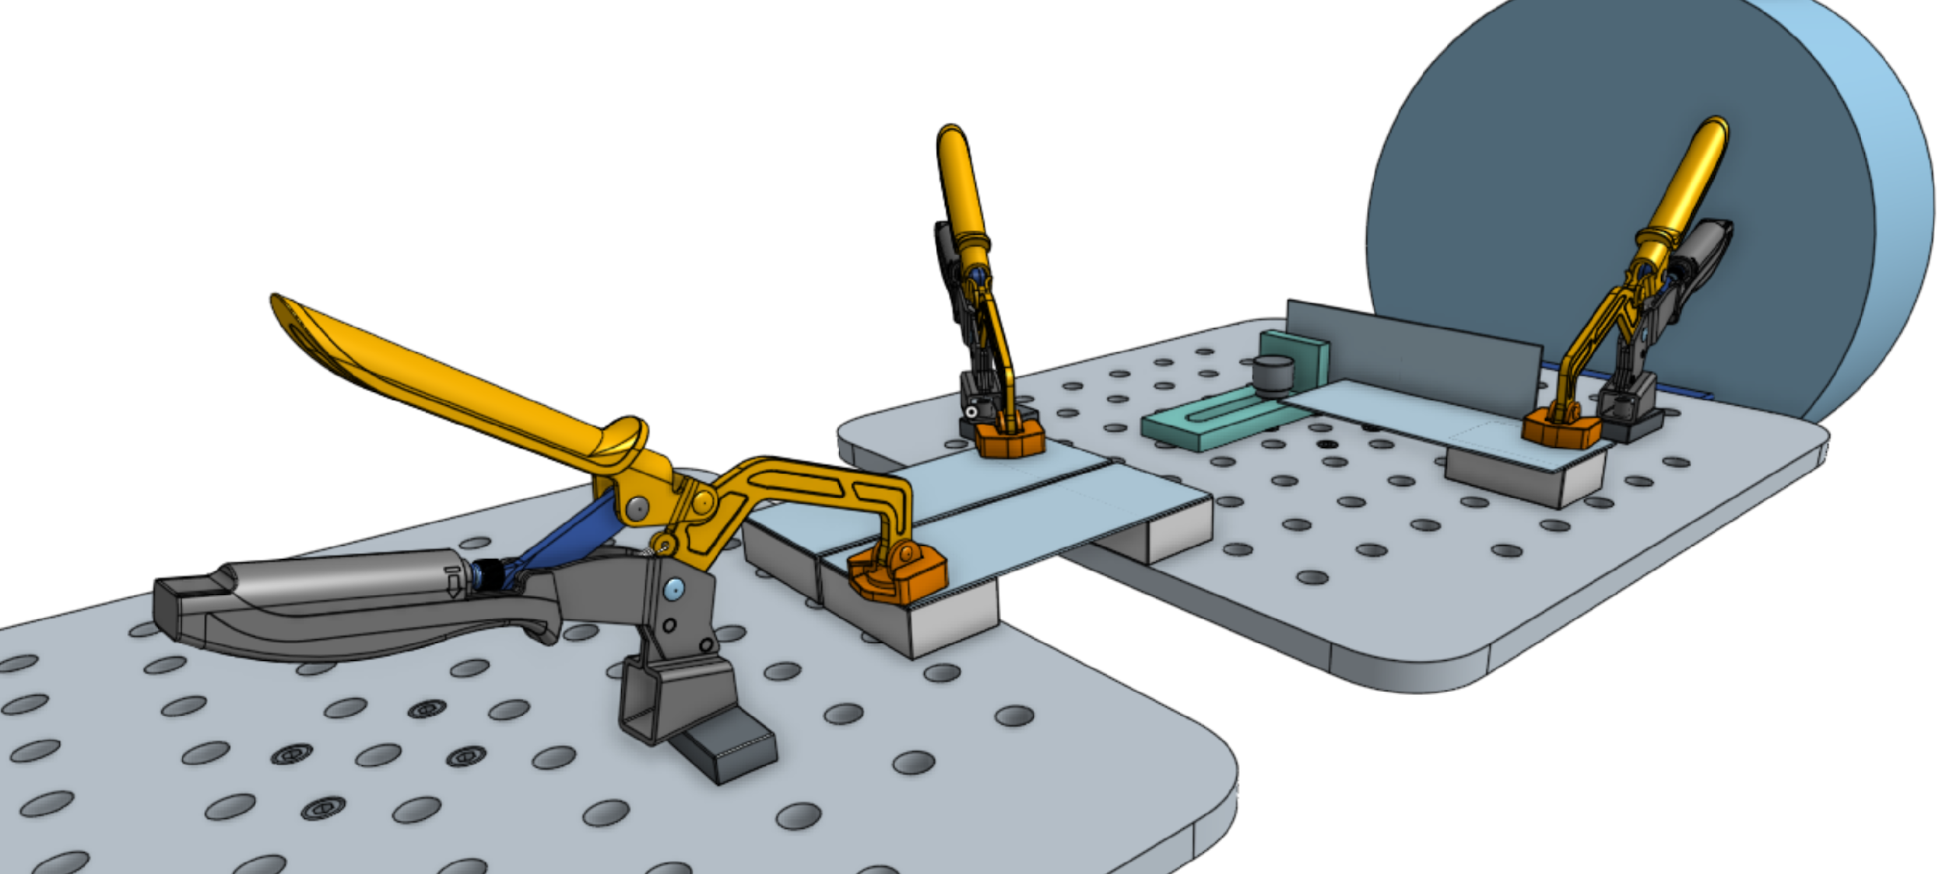

Coupon Welding
Notes:
Swivel base with 1 inch 360 reach and is detachable. The spacer here can be magnetic, so depending on what your welding the part can just stick to the spacer. There's also a right-angle bracket being used here

Slide 7
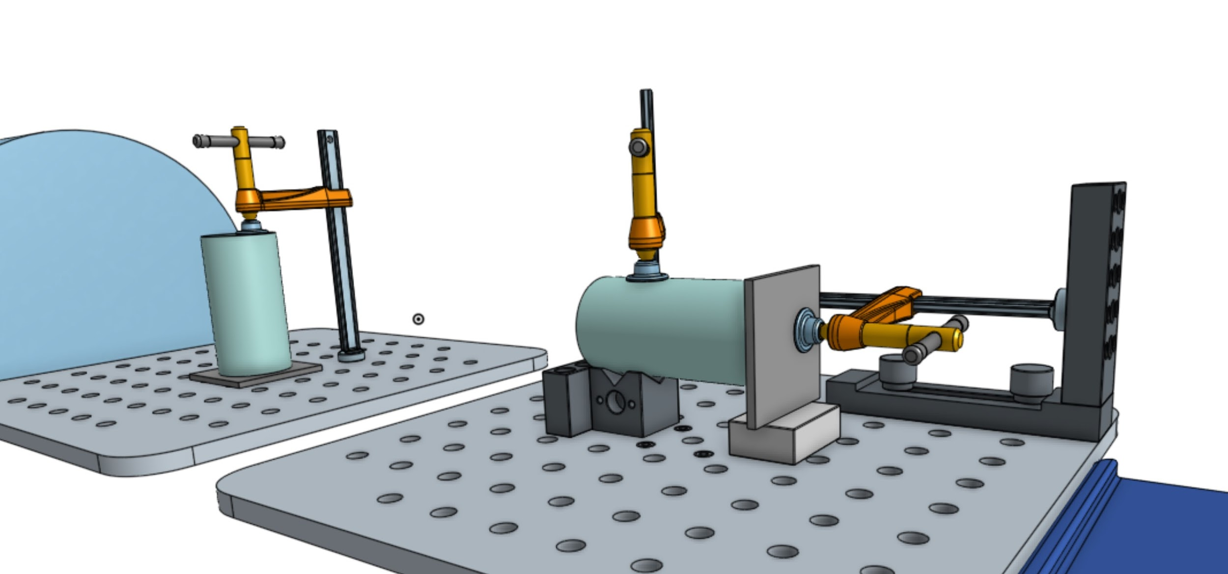
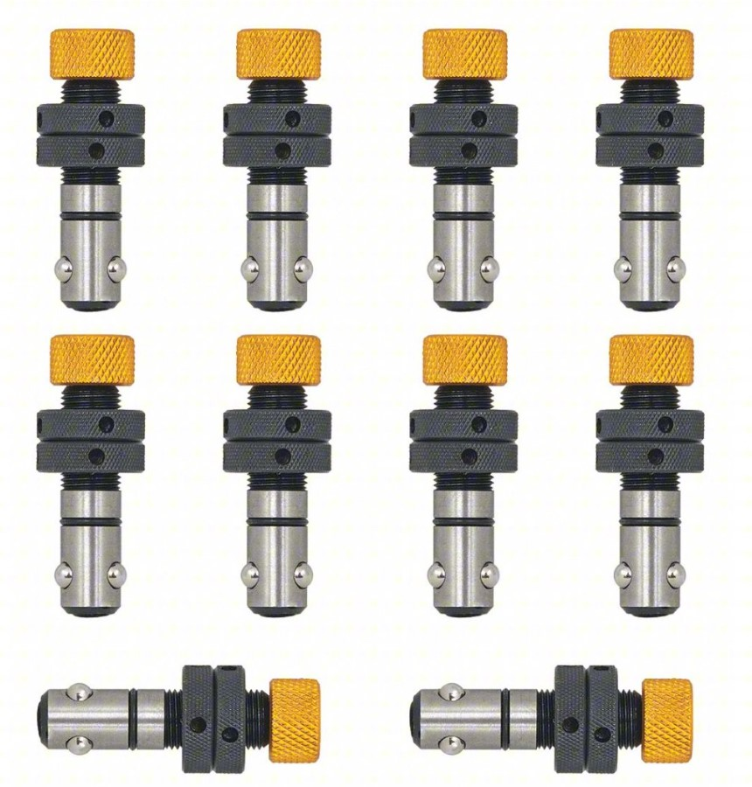
Simple Pipe Welding
Notes:
Ball lock bolt makes it easy to attach different components onto the fixture table securely. so the table can spin 360 without anything falling off. They tighten by twisting the top thumb grip and the ball at the bottom extends out and holds it in place. Super easy to use no special tools needed.

Slide 8
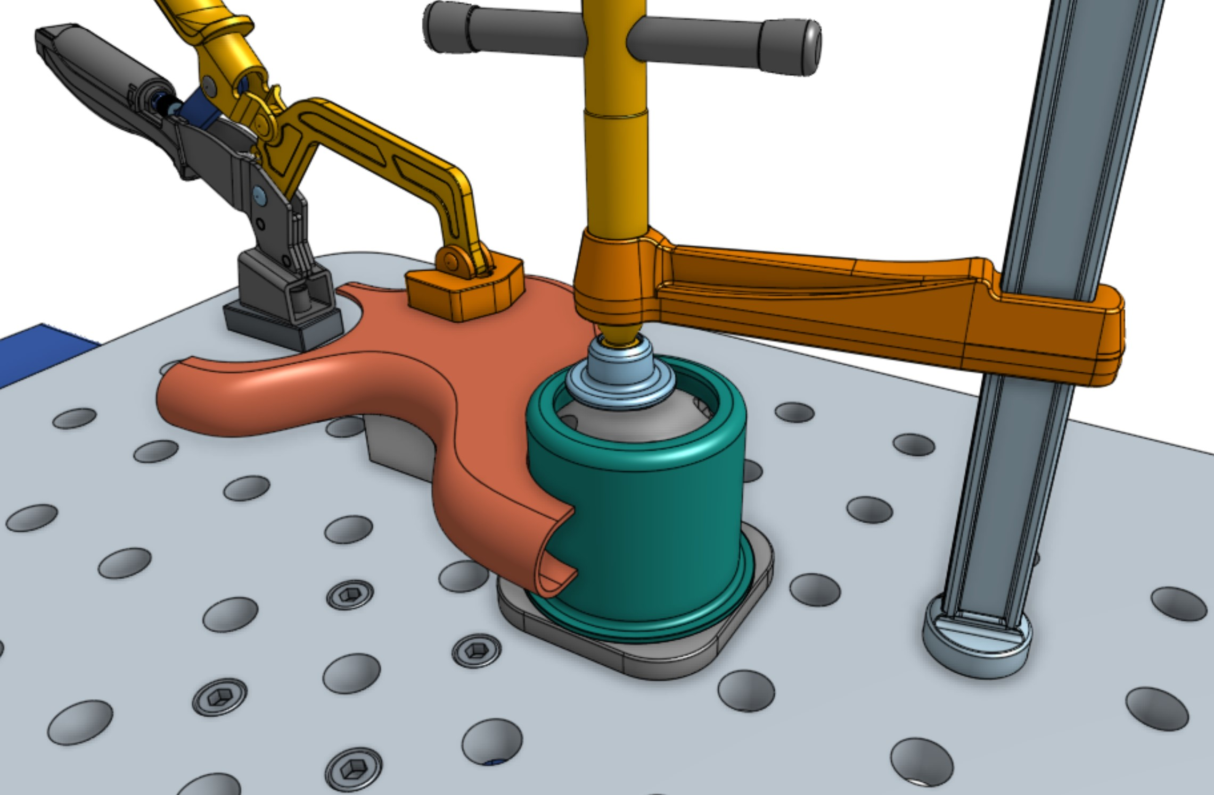
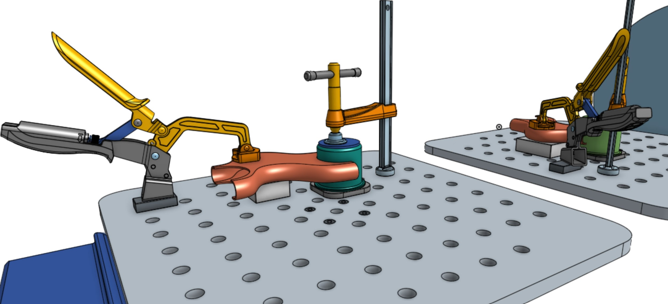
Large and Small Cup Welding
Notes:
The most requested request is the ability to weld cups. The way we can do that is to use a designated holder or fix it in place with some sort of hold down method. For irregular shape parts due to the tables flexibility, we can fab up, 3d print or use something on the market already can work with those parts. There's a lot of freedom here and my idea might not be the best so feel free to throw suggestions. This is just a simple proof of concept

Slide 9
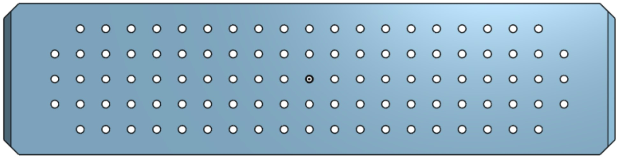
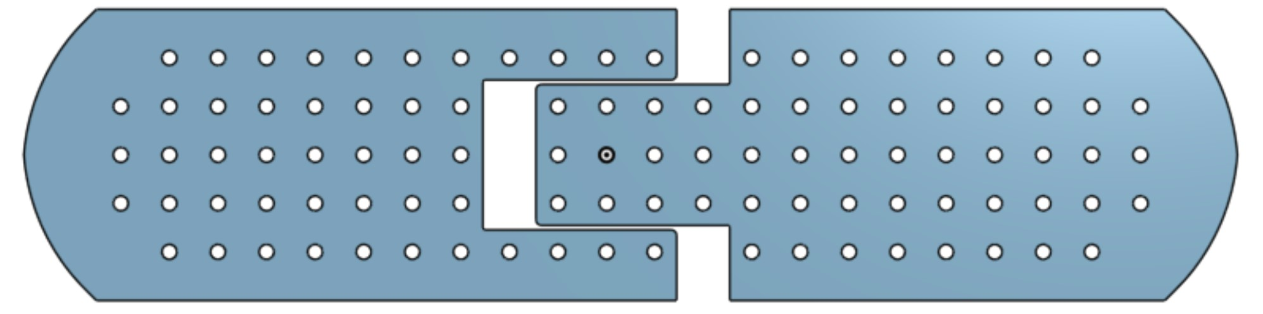
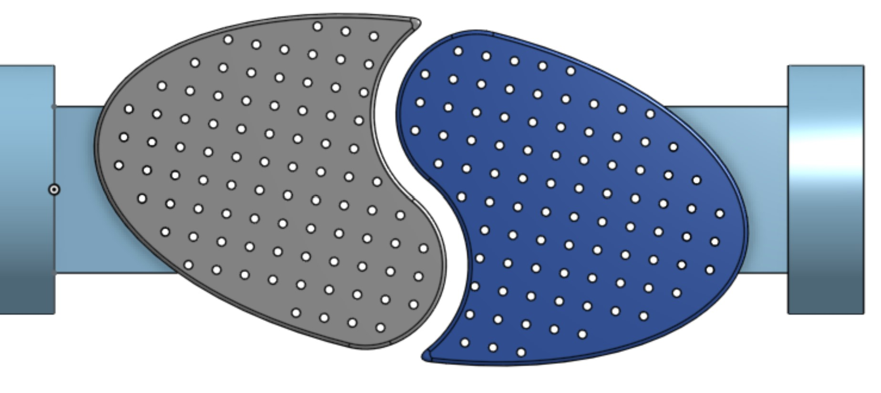
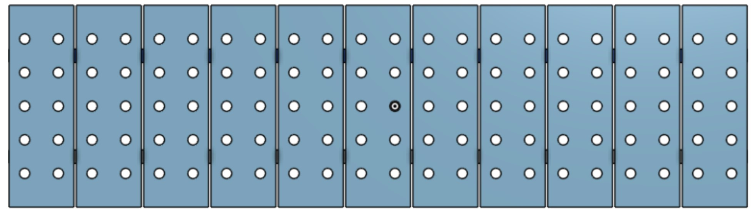
Alternatives
Notes:
Top left: slideable table, top right: full table, bottom right: plank style, bottom left oval style

